Slide 1
Job-Driven Technical Assistance Center (JD-VRTAC) Learning Collaborative State Vocational Rehabilitation Agencies
Learning Collaborative 2018
Washington DC

Slide 2
JD-VRTAC Partners
Institute for Community Inclusion (ICI), Univ. of Massachusetts/Boston
In Partnership with:
Jobs for the Future (JFF)
Univ. of Arkansas/CURRENTS
Univ. of Washington
Council of State Administrators of Vocational Rehabilitation (CSAVR)
In Collaboration with:
National Council of State Agencies for the Blind (NCSAB)
Technical Assistance Center Collaborative

Slide 3
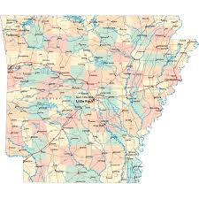
Arkansas Rehabilitation Services
Project Areas: Business Engagement, Labor Market Information
Agency Lead: Rodney Chandler, rodney.chandler@arkansas.gov
TA Lead: Paula Pottenger, ppottenger@uacurrents.org
Goals:
Increase agency collaboration between Business Engagement and Field Services
Increase agency engagement and participation with businesses and provider services
Quick Facts:
General agency in the Department of Career Education
80 VRCs across 19 offices statewide
12 Business Engagement Representatives
Accomplishments
Collaboratively developed Field Office Business Engagement action plans, which have contributed to BERs and VRCs making joint customer visits to local businesses
Providing ongoing quarterly business engagement trainings to workforce partners.
VRC & BER staff are involved at the onset of a consumer’s case to share LMI and create effective IEPs together with consumers.

Slide 4
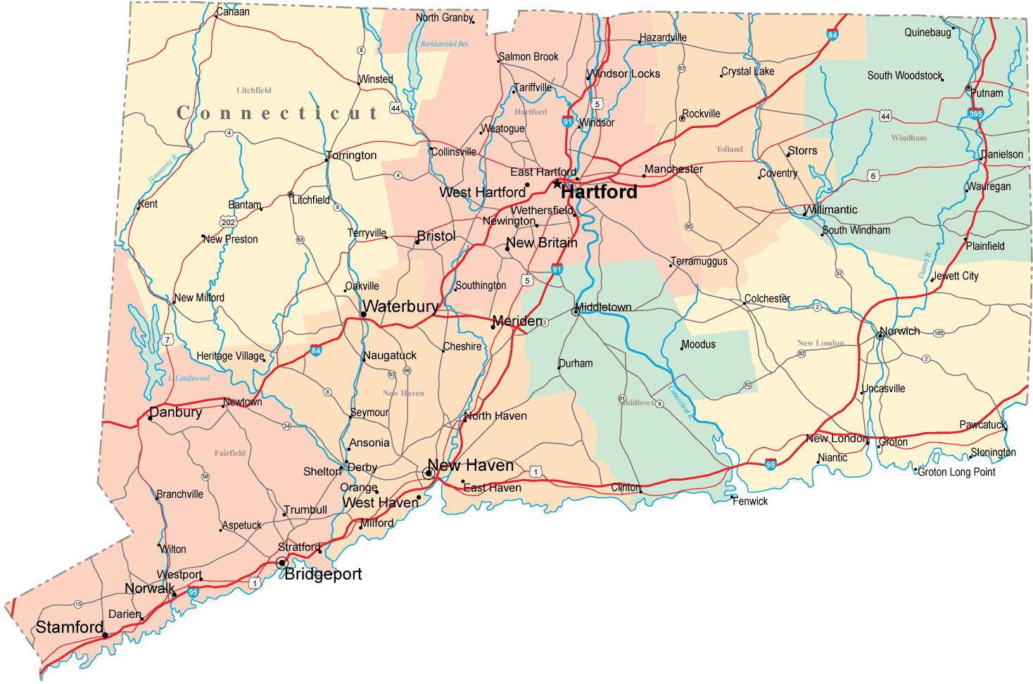
Connecticut Bureau of Education and Services for the Blind
Project Area: Labor Market Information, Business Engagement
Agency Lead: Mary Burgard,
mary.burgard@ct.gov
TA Lead: Vito Desantis,
vito.desantis@umb.edu
Goals:
Increase Systematic Use of LMI by VR Counselors
Decrease in the number of clients choosing careers without good job prospects
Quick Facts:
Blind agency located within Connecticut Department of Rehabilitation Services
10 VR Counselors in one office statewide
Accomplishments
Determined where the use of LMI database fits into the Agency's VR process
Conducted a training on the use of LMI
Determined the use of LMI within the Agency's VR process with post-survey
Reviewed Career Index Plus to determine suitability for use

Slide 5
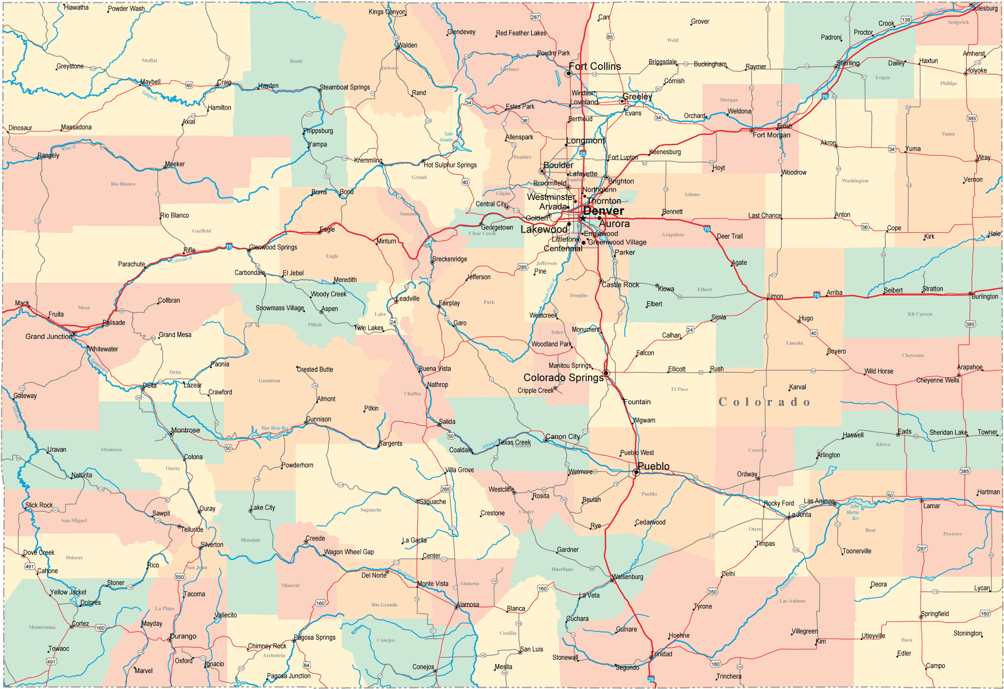
Colorado Division of Vocational Rehabilitation
Project Area: Business Engagement, Labor Market Information
Agency Lead: Jennifer Scilacci, jennifer.scilacci@state.co.us
TA Lead: Dana Jefferson, dana.jefferson@umb.edu
Goals:
Increase the systematic use of LMI within CO DVR to produce better client outcomes, including increased client wages.
Increase business engagement effectiveness through partnerships and skill building.
Quick Facts:
Combined agency in the Department of Labor
105 VRCs across 27-29 offices statewide
9 Employment Specialists
Accomplishments
Determined current LMI use among staff through meetings and surveys
Developed and reviewed LMI training curriculum and related materials
Developed an agency-wide business engagement plan
Completed Business Outreach Specialist staff development plans and trainings.

Slide 6
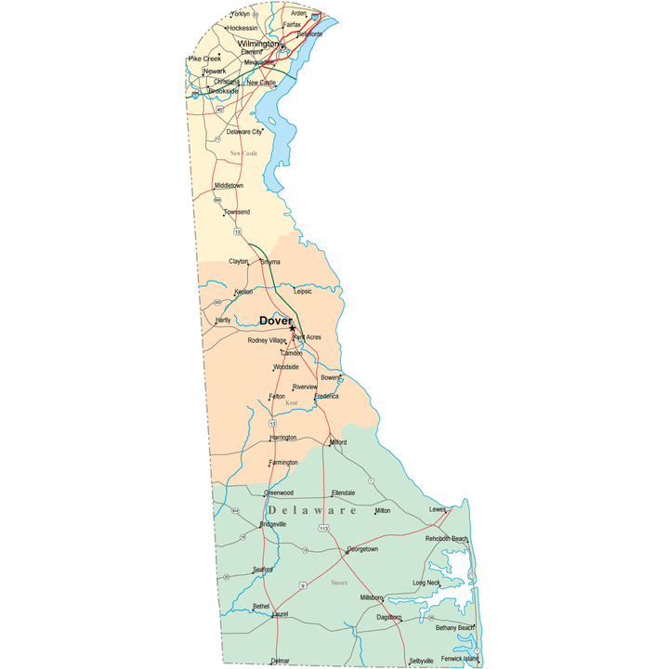
Delaware Division of Rehabilitation
Project Area: Customized Training, Business Engagement
Agency Lead:
Jocelyn Langrehr, jocelyn.langrehr@state.de.us
TA Lead:
Linda Mock, linda.mock@umb.edu
Goals:
Expansion of career pathways programming statewide
Alignment of VR career pathways with Department of Education and Training
Career pathways education statewide
Quick Facts:
General agency housed in the Delaware Department of Labor
40 VR Counselors and VR Counselor Assistants and 5-7 Employment Specialists across five offices statewide.
Accomplishments
Expanded leadership to all state one stop offices: Georgetown, Dover, Newark, Wilmington
Educated VR staff statewide on career pathways
Educated vendors who provide placement services about career pathways

Slide 7
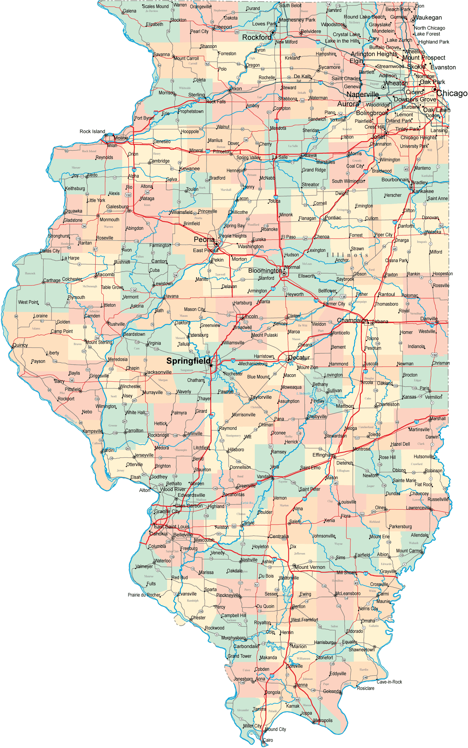
Illinois Department of Rehabilitation Services
Project Area: Business Engagement; Employer Supports
Agency Lead: Douglas Morton, John Marchioro: douglas.morton@illinois.gov; John.marchioro@illinois.gov
TA Lead: Jeanne Miller, jmiller@uacurrents.org
Goals:
Develop an agency-wide business engagement strategy, which involved:
training at least 45 DRS field-level staff on business relations with demonstrated skill gains
establishing successful relationships with 20 business entities
achieving at least 50 successful employment outcomes for VR program customers at those businesses
Quick Facts:
Combined agency in the Department of Human Services
225 VRCs across 47 offices in 5 state regions
5 Employment Resource Specialists
Accomplishments
Created a document of the Business Engagement Services Team (BEST) Roles and Functions
Established WebCM Business Engagement Screen to track business contacts
As of November 2017
trained 85 field staff
established relationships with 180 new businesses.
placed 38 and successfully closed 13 VR customers as a result of the BEST initiative

Slide 8
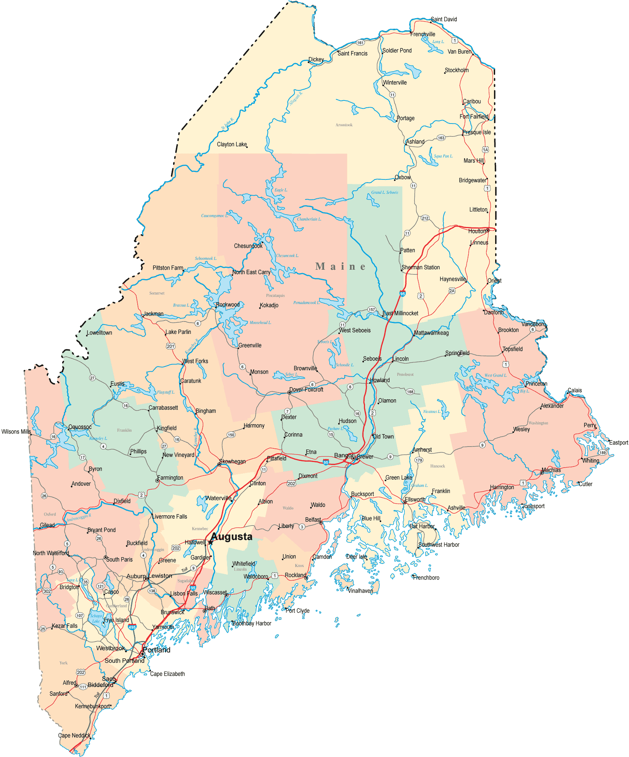
Maine Bureau of Rehabilitation Services
Project Area: Business Engagement; Employer Supports
Agency Lead: Christine Robinson, christine.c.robinson@maine.gov
TA Lead: Linda Mock, linda.mock@umb.edu
Goals:
Improve Connections and Services to Employers with Existing Resources, Including Career Center Partners
Improve Case Management through the use of Technology
Develop a CRP system/process that provides more accountability and improves overall outcomes
Quick Facts:
General agency in the Department of Labor/Bureau of Rehabilitation Services
66 VRCs across 9 offices statewide
1.25 Business Relations Specialists
Accomplishments
DVR Business Relations Staff participate in newly formed Statewide Workforce Action Team (SWAT).
Demonstration and potential pilot of the SARA program
Captured preliminary feedback from CRPs
Generated a CRP expenditures and outcomes report

Slide 9
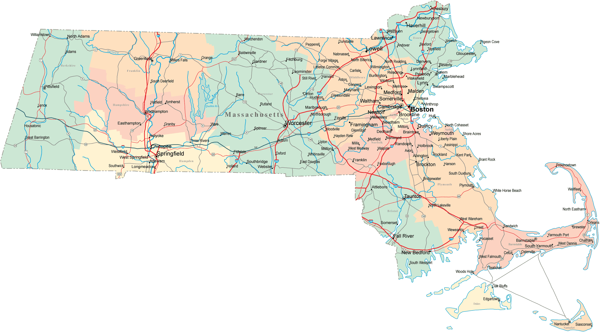
Massachusetts Commission for the Blind
Quick Facts:
Blind agency housed in Massachusetts Department of Health and Human Services
17 VR Counselors and 4 Employment Specialists across four offices statewide.
Accomplishments
Developed a shared Salesforce database containing all data
Developed a training manual and Engage in training activities for users of the database
Created a MOU developed and agreed upon by all partners
Project Area: Business Engagement; Employer Supports
Agency Lead: Joey Buizon, joey.buizon@state.ma.us
TA Lead: Linda Mock, Linda.Mock@umb.edu
Goals:
Strengthen the strategic partnership between MCB, Perkins, Carroll Center
Develop a shared database of Massachusetts employers

Slide 10
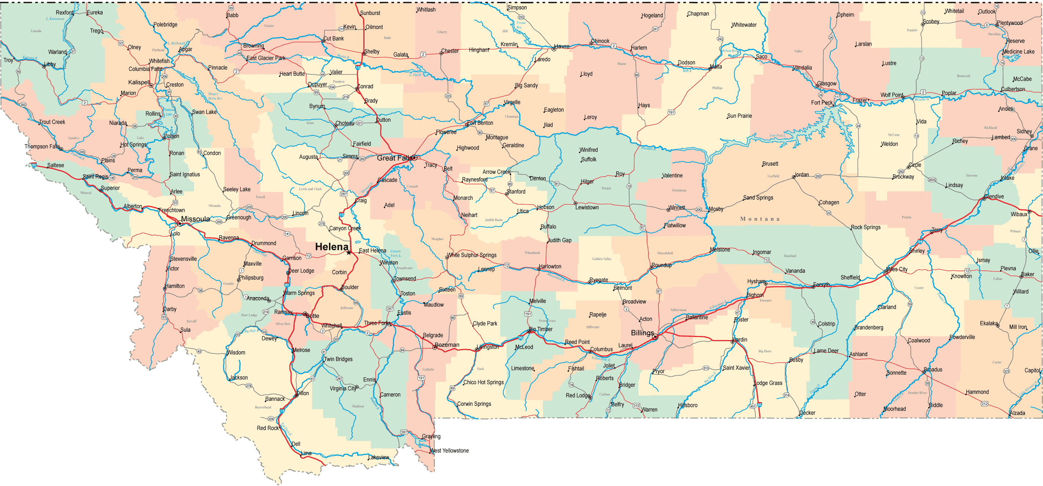
Montana Department of Vocational Rehabilitation and Blind Services
Project Area: Business Engagement, Labor Market Information
Agency Lead: Chanda Hermansen-Dudley, Hermanson-Dudley, ChandaHD@mt.gov
TA Lead: Laurie Ford, lhf4@uw.edu
Goals:
Develop capacity to engage and support business
Develop and implement a communication strategy
Develop marketing materials
Integrate LMI into the counseling process
Quick Facts
Combined agency in the Department of Public Health and Human Services
48 VRCs across 11 offices statewide
No Employment Specialists
Accomplishments
Systematically sharing business contacts and data with workforce partners (Job Services)
Completed Windmills Train-the Trainer in collaboration with Workforce partners
Business Services team participating on Job Services Employer Councils and Chamber meetings
Developed business-focused website and marketing content about VR services to business
Received LMI training from Department of Labor and industry

Slide 11
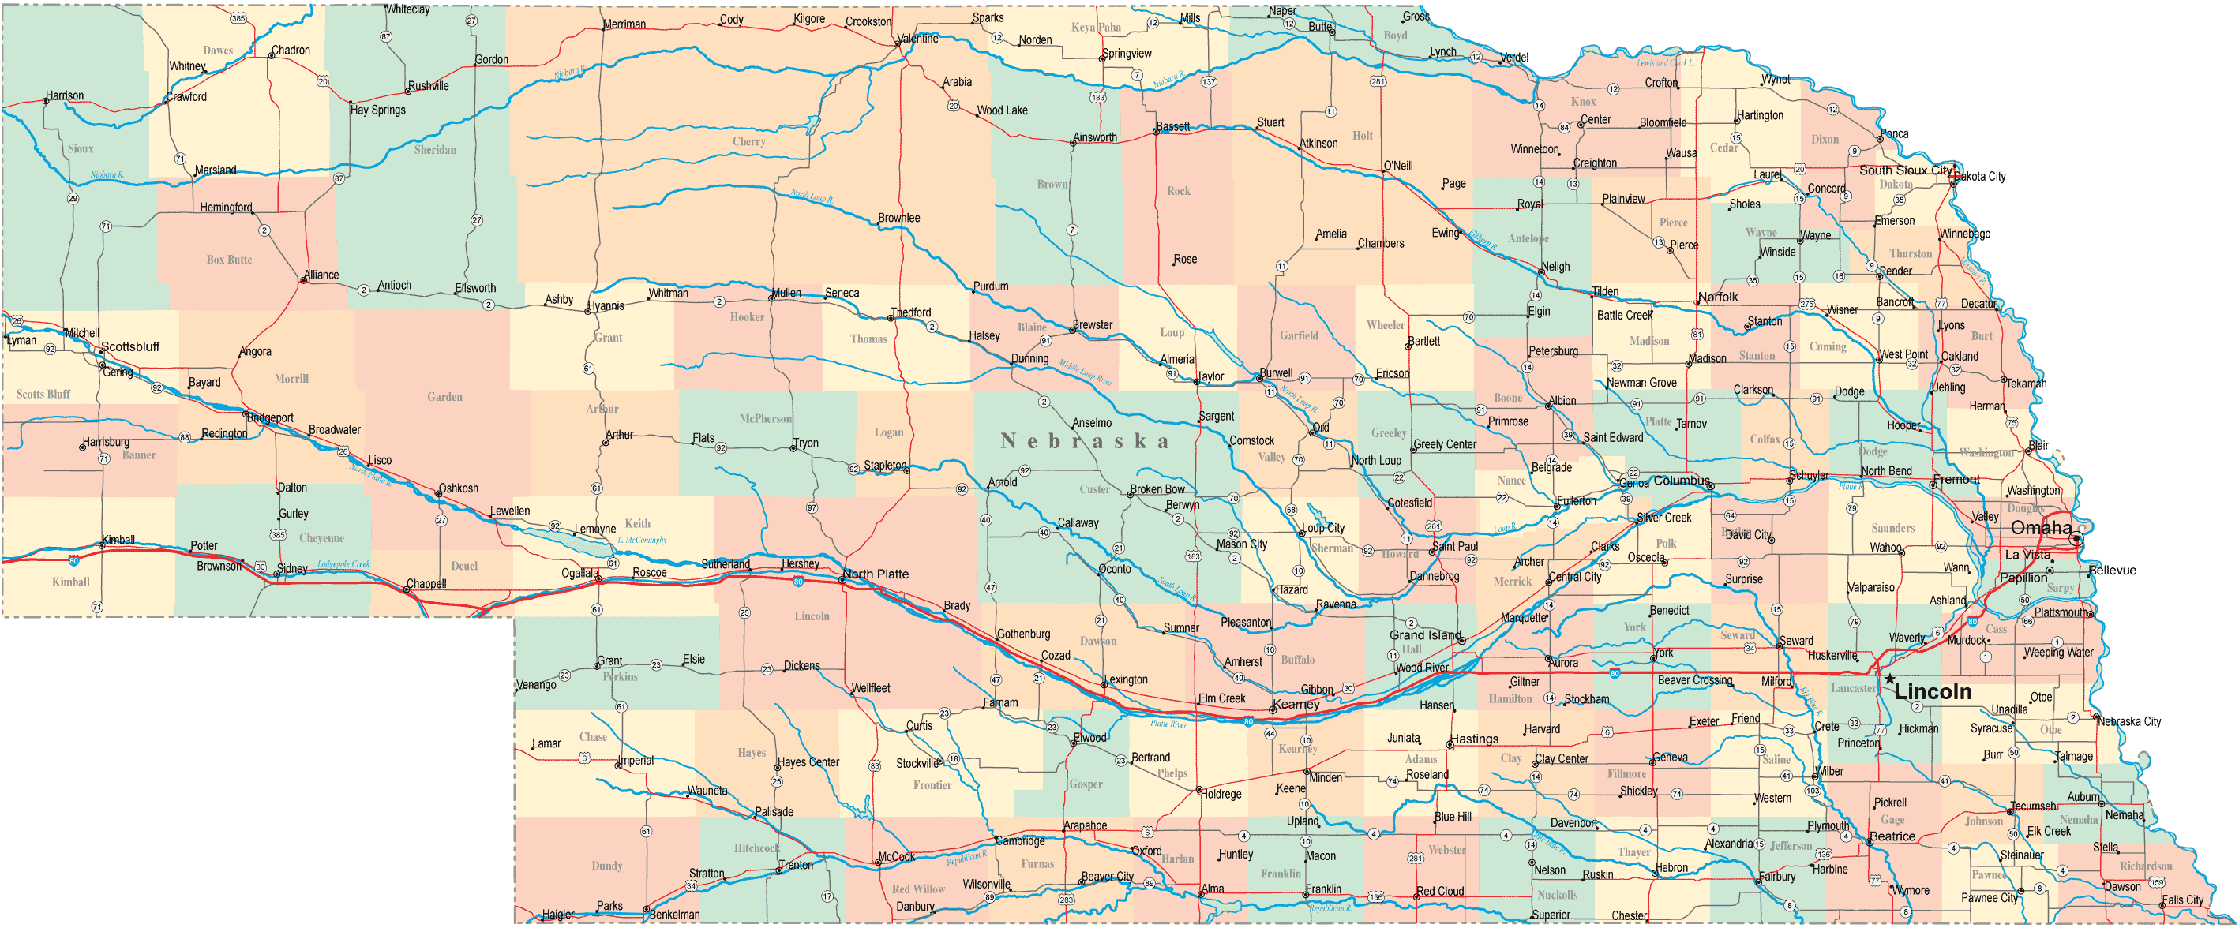
Nebraska Vocational Rehabilitation
Project Area: Business Engagement
Agency Lead: Paige Rose
TA Lead: Neil McNeil
Neil.McNeil@umb.edu
Goals:
Increase agency buy-in of customized employment (CE)
Increase development of business
engagement competencies
Develop CE components and
competencies for VR staff and providers
Increase business engagement in CE
Establish policies around CE and Discovery
Quick Facts
General agency in the Department of Education
45 VRCs and across 11 field offices
4 Business Account Managers (BAMs)
Accomplishments
Trained 98 VRCs and 66 service provider staff on Customized Employment and completed pre/post training survey
Developed two videos highlighting CE from an employer’s perspective
Developed 6 customized employment opportunity proposals with employers as of November 2017.
Determined business engagement activities and processes for BAMs and job placement staff to report.

Slide 12
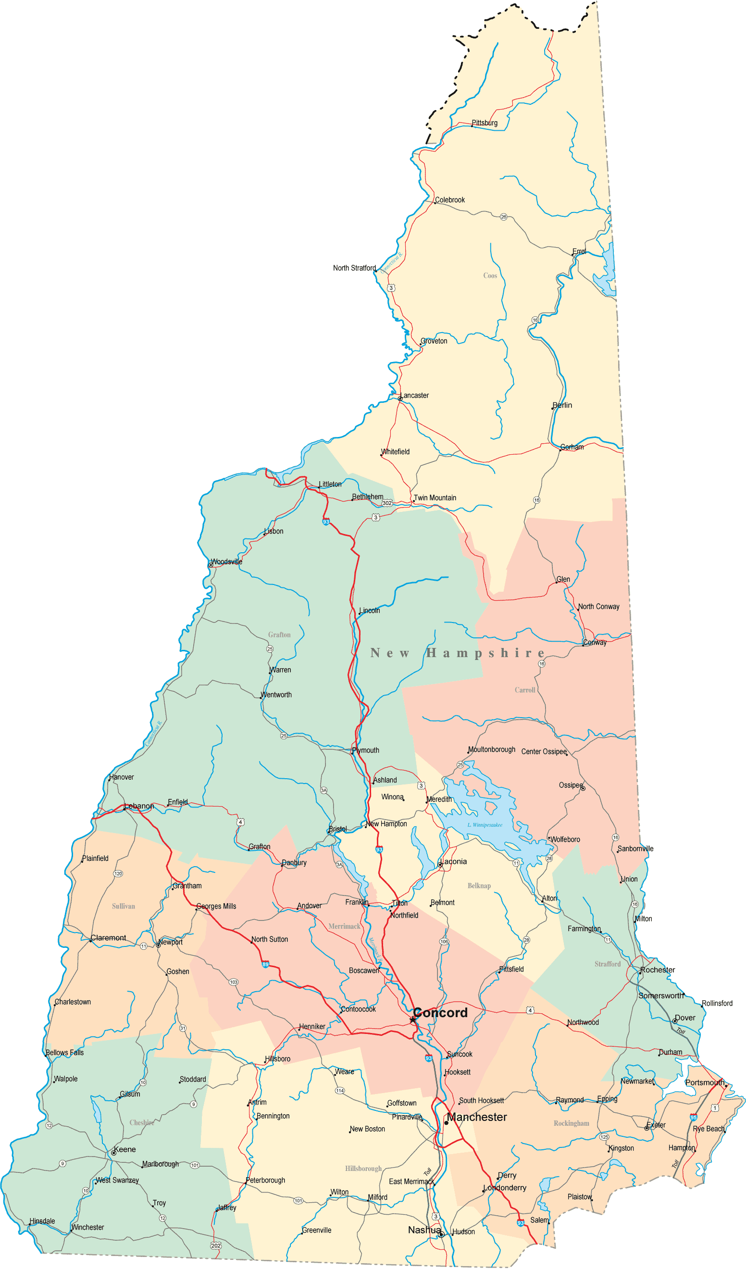
New Hampshire Vocational Rehabilitation
Project Area: Business Engagement
Agency Lead: Lisa Hinson- Hatz, lisa.hatz@doe.nh.gov
TA Lead: Cecilia Gandolfo, cecilia.gandolfo@umb.edu
Goals:
Evaluate current business engagement, job development & placement services
Provide agency framework and planning parameters for regional staff
Formalize role and function of NHVR central office/ corporate/ business relations unit
Quick Facts
Combined agency in Department of Education
41 VRCs across 7 offices statewide
1 Business Engagement Administrator
1 Employment Placement Specialist, 1 Program Specialist III, and 1 Public Relations Specialist
Accomplishments
Developed a Work Based Learning menu of services, launched in the summer of 2017
Finalizing vision for BEU marketing material
Enhanced communication with CRPs to meet BE goals and enhance collaboration
Trained staff on the NEOSERRA program to collect business engagement activities
Provided in depth, disability specific trainings to a businesses
Creation of business engagement unit policy

Slide 13
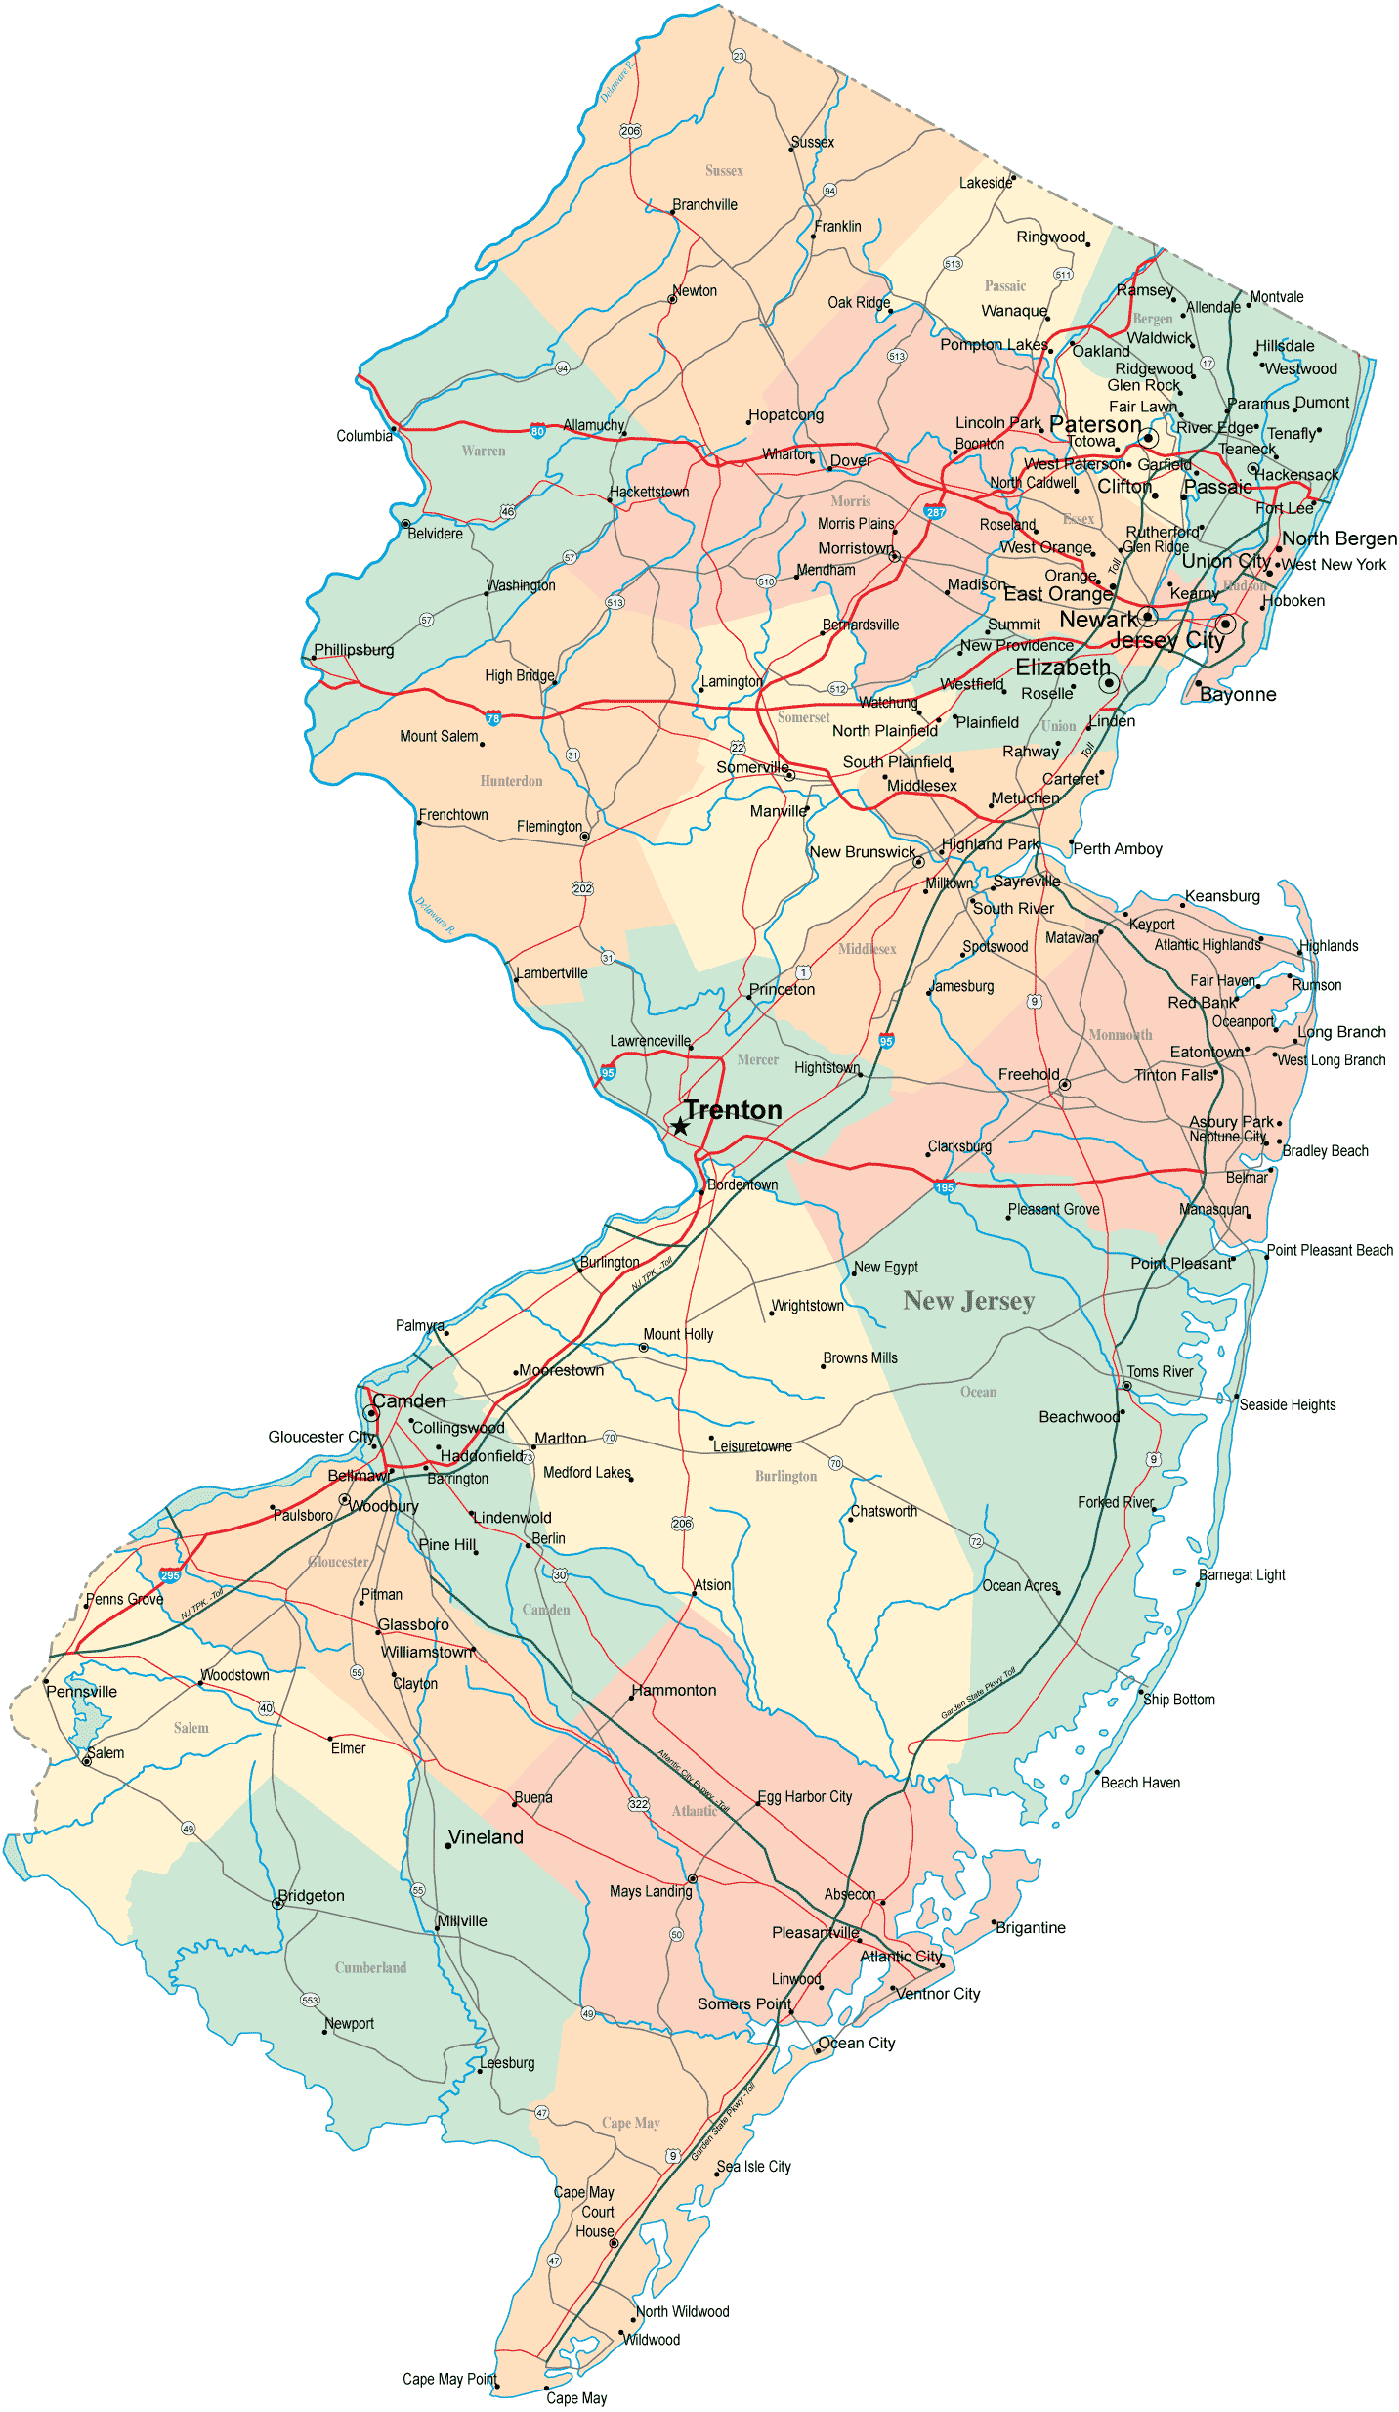
New Jersey Division of Vocational Rehabilitation
Project Area: Business Engagement
Agency Lead: David Free, David.free@dol.nj.gov
TA Lead: Dana Jefferson, dana.jefferson@umb.edu
Goals:
Create a consistent and unified approach to business outreach, which involved:
Hiring a Business Outreach Team Chief
Identifying skill sets for BOT reps
Determining BOT roles, expectations, and performance measures
Identifying communication plan for all business outreach partners
Quick Facts
General agency in the Department of Labor
140 VRCs across 18 field offices; 16 offices are co-located in One-Stops
1 Business Outreach Chief and 6 Program Development Specialists
Accomplishments
Developed comprehensive job descriptions
Hired Business Outreach chief and team
Identified the desired skills for BOT representatives
BOT representatives received training on team protocols, structure, function, vision, and rationale for engaging business in VR.

Slide 14
New Jersey Commission for the Blind and Visually Impaired
Project Area: Business Engagement, Labor Market Information
Agency Lead: Amanda Gerson, Amanda.Gerson@dhs.state.nj.us
TA Lead: Linda Mock, Linda.Mock@umb.edu
Goals:
Develop a sustainable model for the Business Relations Unit (BRU) based on promising and emerging job-driven practices
Develop a model to effectively use Labor Market Information (LMI).
Quick Facts
Blind agency in the Department of Human Services
29 VRCs and 12-14 Technology Services Specialists across 4 offices statewide
2 Business Relations Specialists and 1 Business Relations Manager
Accomplishments
Established/staffed a Business Relations Unit (BRU)
Trained VRCs on the Talent Acquisition Portal (TAP) and Labor Market Information
Hosted a reverse-job fair, which allowed consumers to present their job skills and interests to 15 local employers.
Hosted first Business Summit with 10 business partners to dispel myths and misconceptions about blindness, provide accessibility training, and educate businesses about what the BRU can offer.
Developed comprehensive soft-skills training to deliver quarterly to consumers.

Slide 15
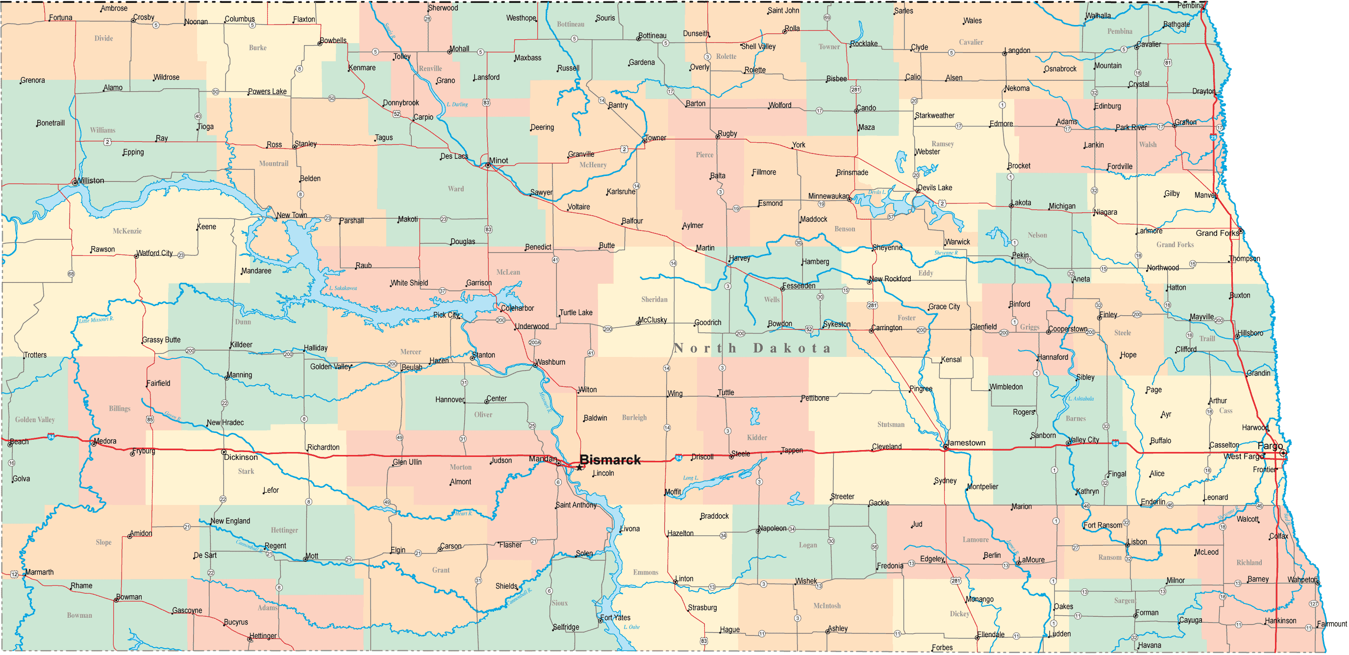
North Dakota Division of Vocational Rehabilitation
Project Area: Labor Market Information
Agency Lead: Brenda Vennes, bvennes@nd.gov
TA Lead: Terry Brigance, tbrigance@uacurrents.org
Goals:
Improve Business Engagement Practices
Increase VR counselor and VR client use of LMI
Quick Facts
General agency located within the North Dakota Department of Human Services
42 VR Counselors and 3 business engagement staff across eight offices statewide
Accomplishments
Completed Best Practice Guidelines for business engagement
Presented Guidelines to statewide ND DVR Staff
Establishing 40 employer contacts per counselor
Implemented and completed pilot of LMI
Presented LMI process to statewide to ND DVR Staff

Slide 16
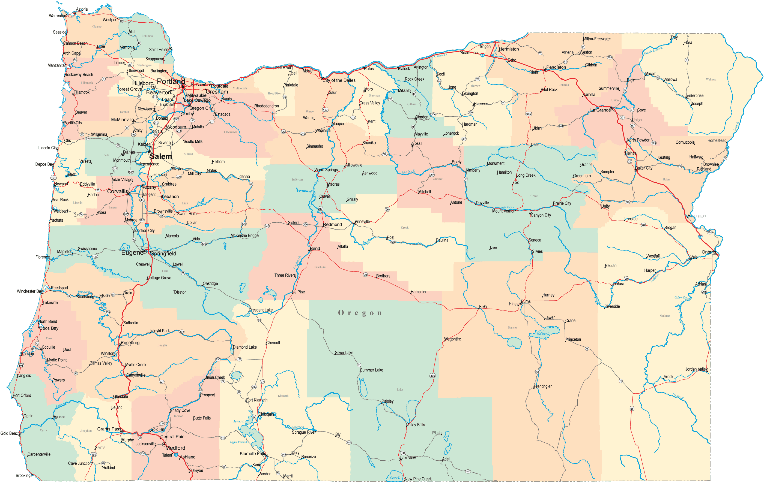
Oregon Commission for the Blind
Project Area: Business Engagement
Agency Lead: Morgan Rincon, morgan.rincon@state.or.us
TA Lead: Vito DeSantis, vito.desantis@umb.edu
Goals:
Strategically build a highly responsive and efficient business relationship capacity by maximizing resources available in state
Coordinate business engagement activities with partners
Quick Facts:
Agency for the blind, an Independent Commission
9.5 VRCs across 5 offices statewide
3 Business Relations Coordinators
Accomplishments
Created marketing and success stories videos for Oregon businesses audiences
Business Relations Consultants trained VRCs, CRP job developers, and workforce partners
Hired additional business engagement staff to provide state-wide coverage
Developed a combined business engagement team with Workforce and defined team roles and objectives

Slide 17
Oregon Vocational Rehabilitation
Project Area: Business Engagement
Agency Lead: Keith Ozols, keith.ozols@dhsoha.state.or.us
TA Lead: Russ Thelin, russell.thelin@umb.edu
Goals:
Expand existing business relations capacity for greater statewide engagement.
Coordinate business engagement with specific employment sectors (health care, etc.)
Quick Facts:
General Agency, Department of Human Services
126 VRCs across 43 offices statewide
1 Business Relations Coordinator
Accomplishments
Connected to the JDVRTAC for resources and TA to expand business engagement effort.
Business relations partnership between BE staff of Oregon and Washington VR programs.
With WA-DVR, created the Interstate Disability Employment Alliance (IDEA) for joint-state business engagement in the Portland, OR/Vancouver, WA metro area.

Slide 18
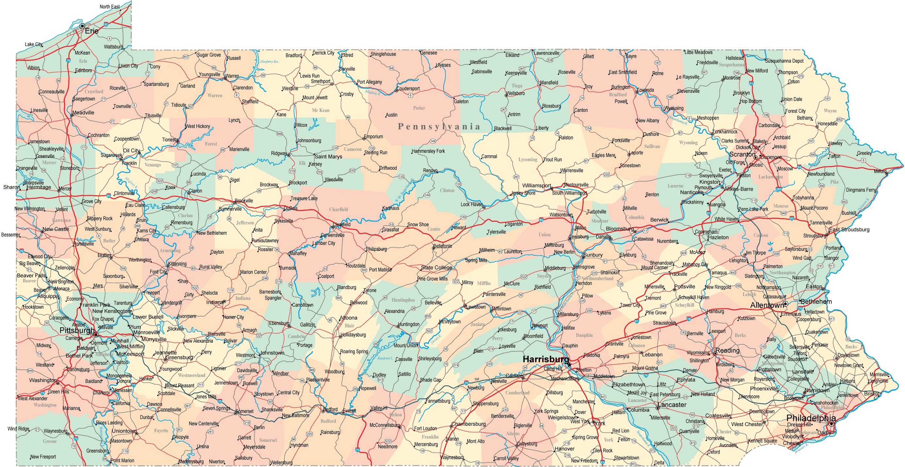
Pennsylvania Office of Vocational Rehabilitation
Project Area: Labor Market Information
Agency Lead: Cindy Mundis, cmundis@pa.gov
TA Lead: Vito Desantis, vito.desantis@umb.edu
Dana Jefferson
Dana.jefferson@umb.edu
Goals:
Integrating Labor Market Information (LMI) into the Vocational Rehabilitation (VR) Process
Engaging Employers to Hire Minors
Quick Facts:
combined agency in the Pennsylvania Department of Labor and Industry
400 VR Counselors and a centrally managed team of Business Services Representatives across 21 offices statewide.
Accomplishments
Coordinated with Center for Workforce Information and Analysis (CWIA) re: available LMI tools
Developed LMI Awareness/Use Survey
Developed LMI and employer engagement training curriculum
Conducted Business Roundtable via Governor's Advisory Committee
Hired new business engagement staff

Slide 19
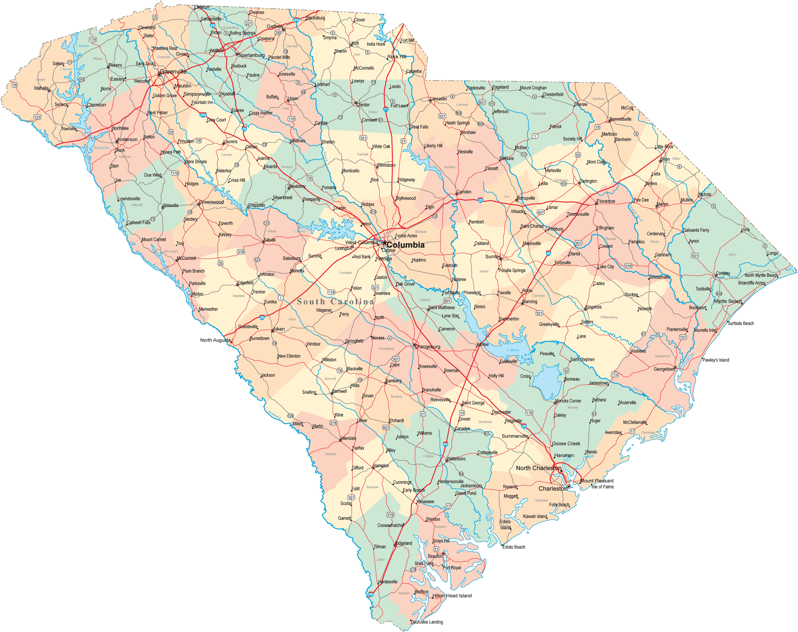
South Carolina Vocational Rehabilitation Department
Project Area: Business Engagement, Customized Training
Agency Lead: Darline Graham,
dgraham@scvrd.state.sc.us
TA Lead: Russ Thelin, russell.thelin@umb.edu
Goals:
Increase Customized Training Opportunities
Increase Capacity of Business Development Specialists to Engage Businesses
Continue to Improve Data Collection/Career Connect
Quick Facts:
General agency and an independent Commission
287 VR Counselors and 21 Business Development Specialists across 24 offices statewide
Accomplishments
Expanding customized training partnership with Sloan Construction to include participants from WIOA partner program
Partnership with ReadySC and Trident Technical College Lean Manufacturing course
Workgroup meetings to assess capacity of Career Connect and the Universal Business System to capture business engagement information.

Slide 20
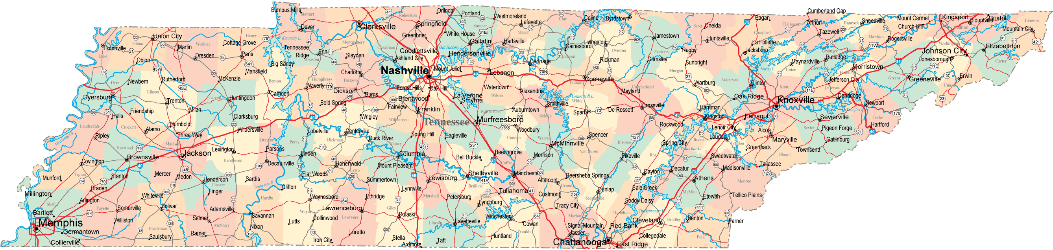
Tennessee Division of Rehabilitation Services
Project Area: Business Engagement
Agency Lead: Paula Knisley, Paula.knisley@tn.gov
Amy Rader, Amy.rader@tn.gov
TA Lead: Kathe Matrone, matrok@uw.edu
Goals:
Build agency capacity in working with the business community
Strengthen training opportunities for staff focusing on building and maintaining employer relations
Enhance data collection processes to support the Business Service Unit
Quick Facts:
Combined agency in the Tennessee Department of Human Services
105 VR Counselors and 12 Business Employment Consultants across 11 offices statewide
Accomplishments
Established a senior level Director of Business Services Position and new Agency Leadership Team
Implemented regular meetings to share information and increase collaboration with BECs across the state
Revised contract with UT, allowing more opportunities for them to train BEC staff on business engagement topics of interest
Sustained a tracking mechanism (excel spreadsheet) for business engagement activities and outcomes.

Slide 21
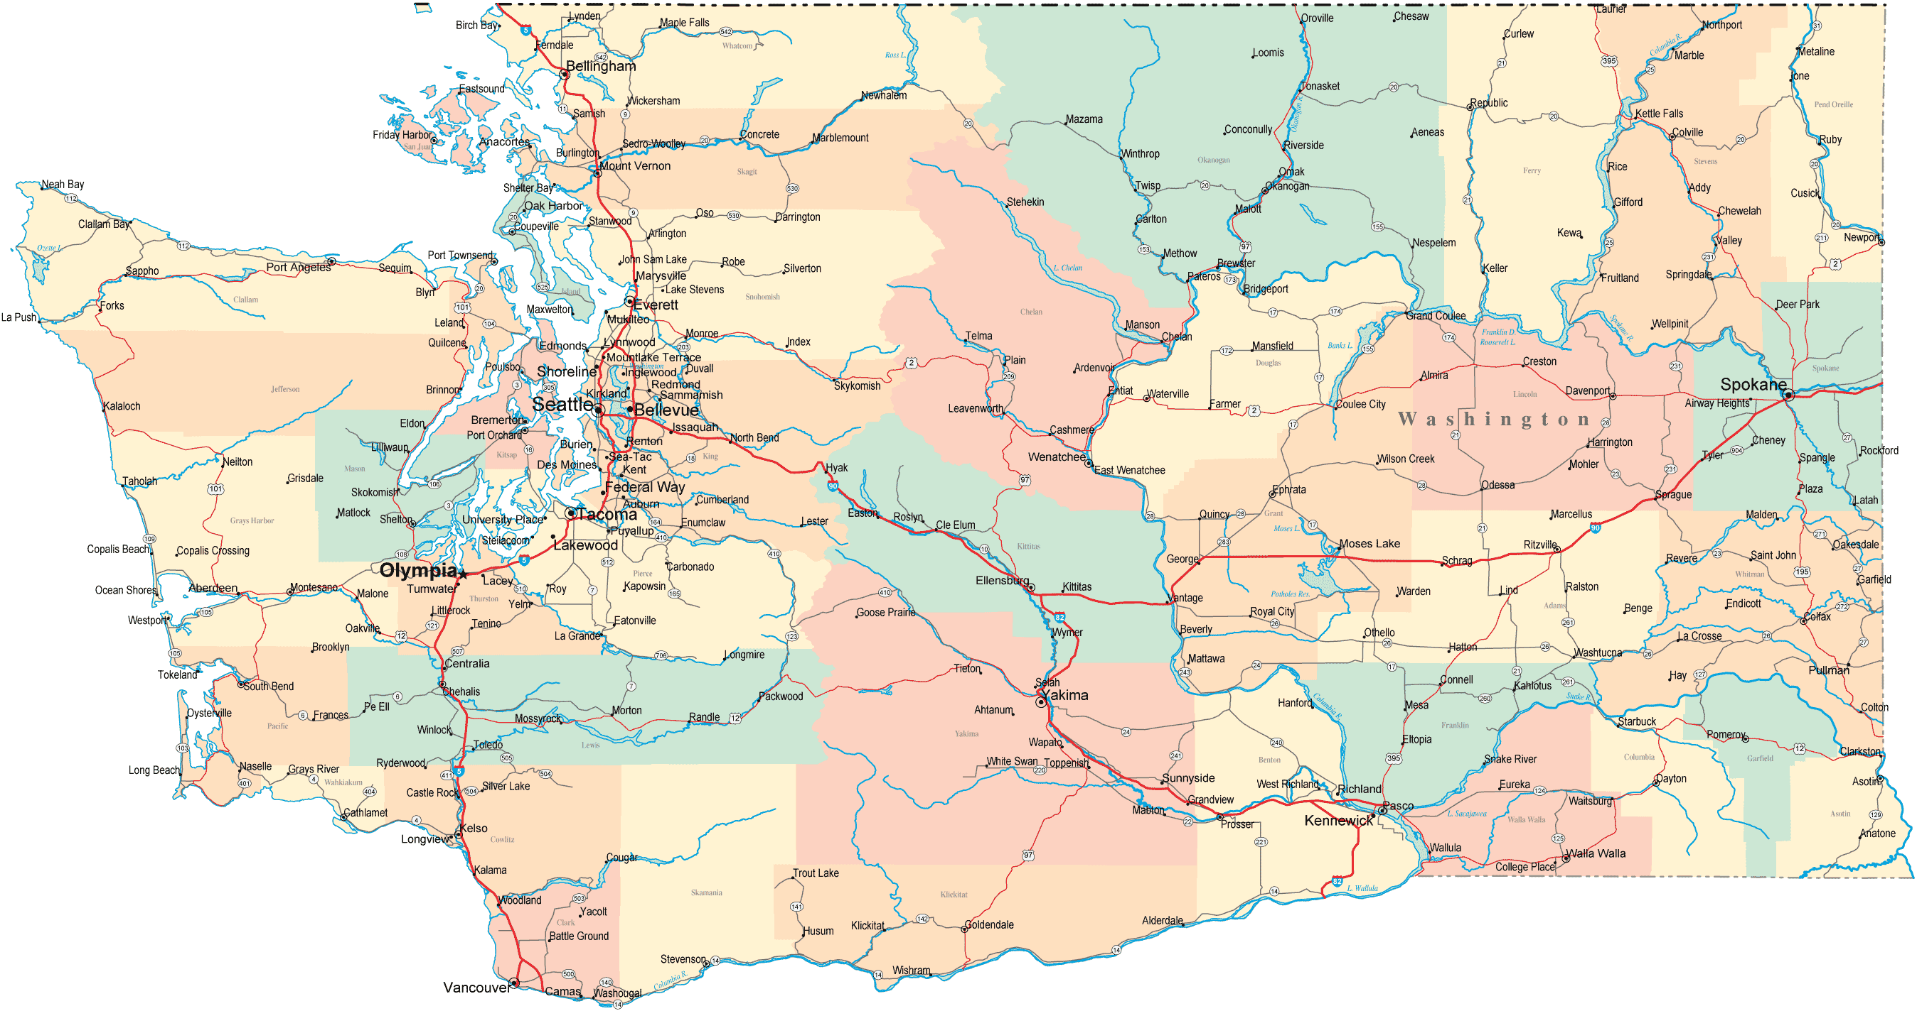
Washington Department of Vocational Rehabilitation
Project Area: Business Engagement
Agency Lead: Karen Miceli,
Karen.miceli@dshs.wa.gov
TA Lead: Russ Thelin, russell.thelin@umb.edu
Goals:
Establish business relations within WA-DVR.
Expand capacity for business engagement for greater statewide availability.
Establish partnerships with key business partners including, but not limited to; WorkSource, Chambers of Commerce, CSAVR NET, agency generated contacts.
Quick Facts:
General Agency in the Washington Department of Social and Health Services.
One lead Business Engagement Manager and 18 business engagement specialists.
Accomplishments:
Established job description for business engagement staff within the agency .
Placed business engagement specialists in locations throughout Washington.
Created data elements spreadsheet to gather information on business engagement activities for reporting and continuous improvement purposes.
Successfully partnering with WorkSource, SHRM, Chambers, and CSAVR Net.

Slide 22
Contact Information
Firstname Lastname
(617) 287-XXXX
firstname.lastname@umb.edu
www.explorevr.org
www.communityinclusion.org

